Slide 1
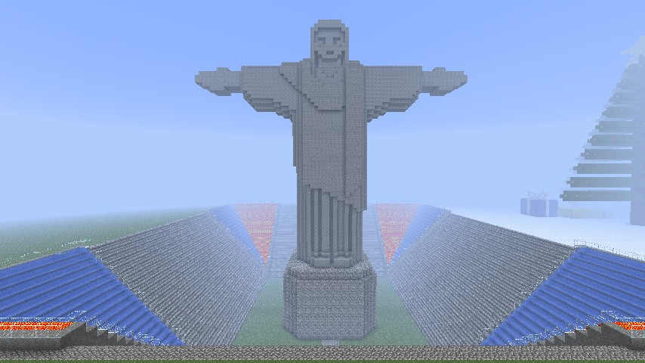
Copycat cities
Felipe Buchbinder

Slide 2
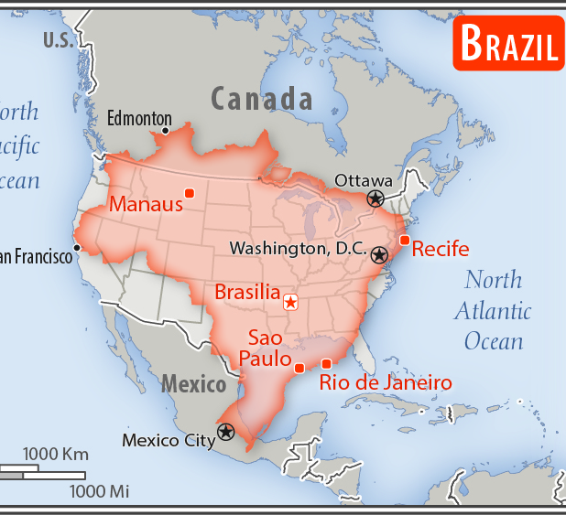
BRAZIL IS BIG
Source: https://www.cia.gov/library/publications/the-world-factbook/geos/print_br.html

Slide 3
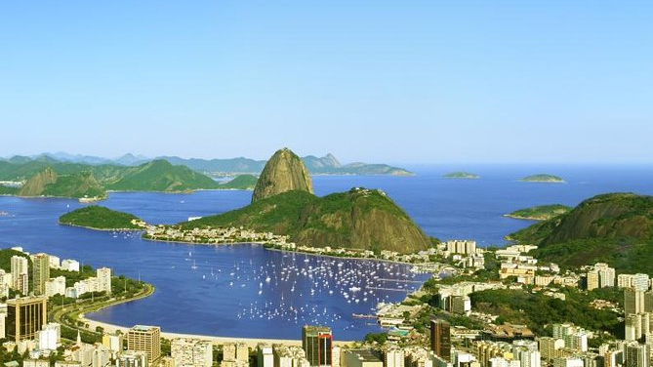
5,423

Slide 4
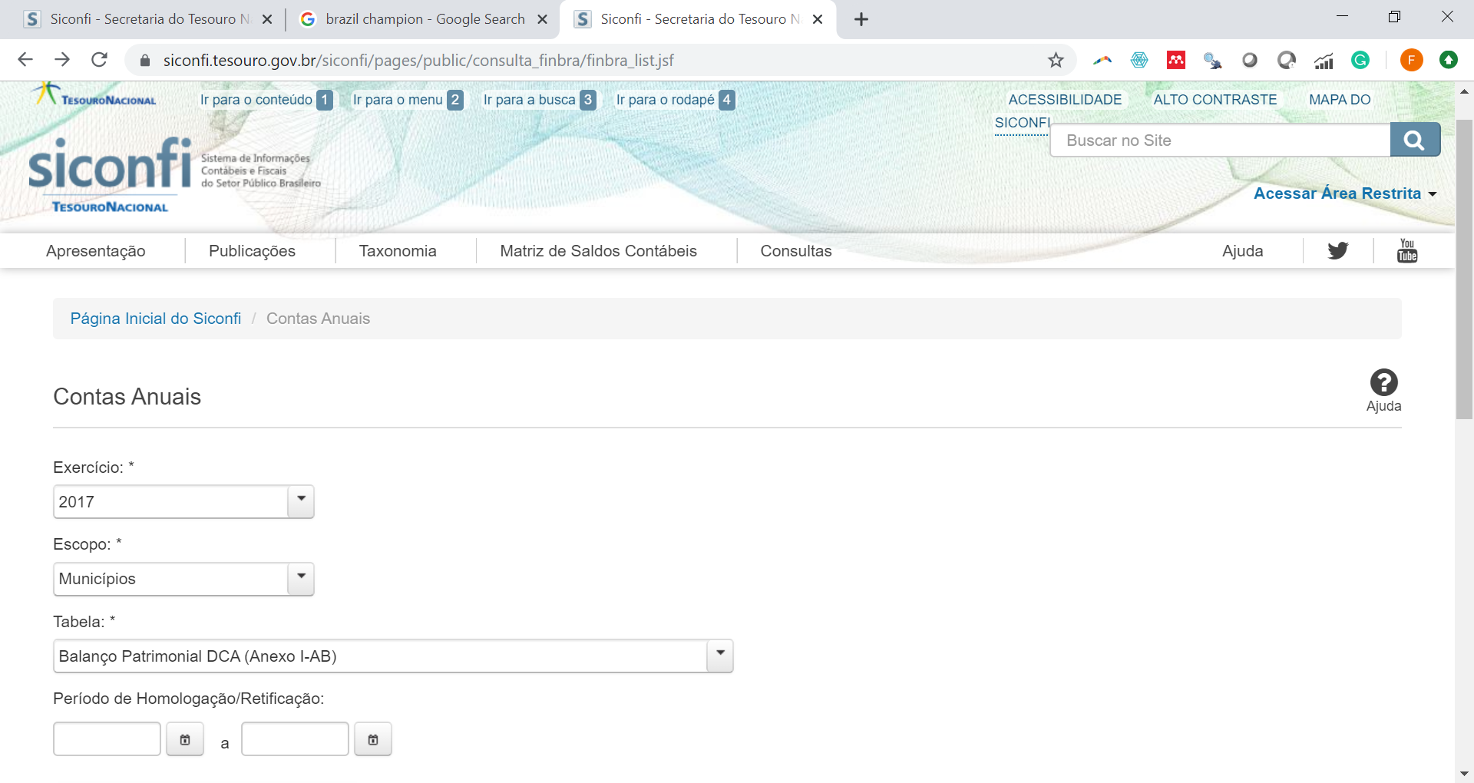

Slide 5

1

Slide 6

Cities copy accounts from one another
Smaller, poorer and less-developed cities are more likely to copy other cities’ accounts.
Cities are more prone to copying accounts if their accountant is outsourced, especially if the same accountant is responsible for diferente cities (shared accountant)

Slide 7
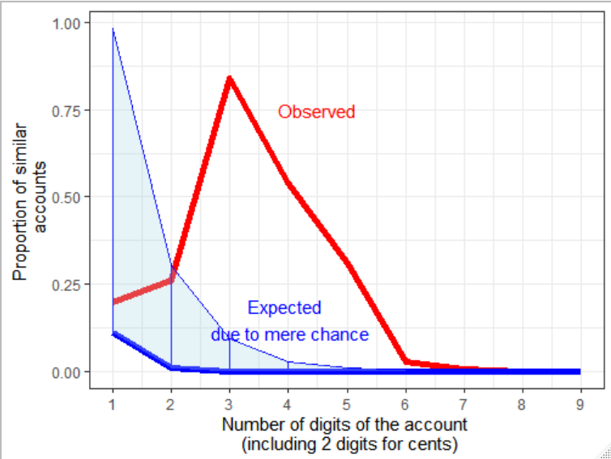
How can we know someone is copying?
How many matches of N-digit accounts would we expect to have due to sheer randomness?
We have many more!
CITIES SEEM TO BE COPYING EACH OTHER!
INSIGHT: Copycat cities copy mostly accounts of small values (Why? Draws less attention?)

Slide 8
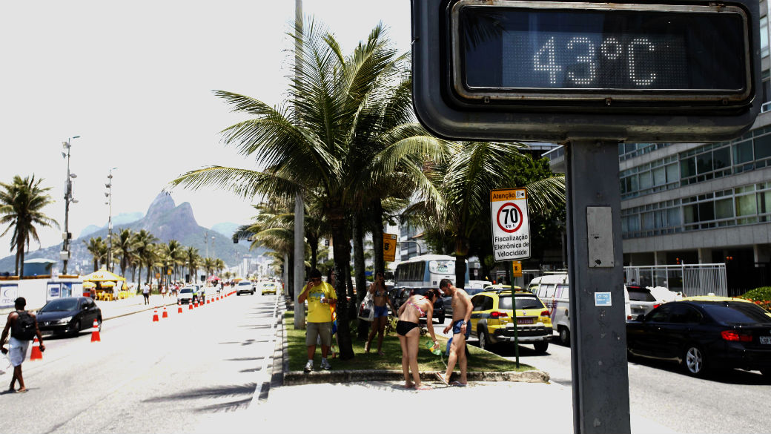

Slide 9


Slide 10
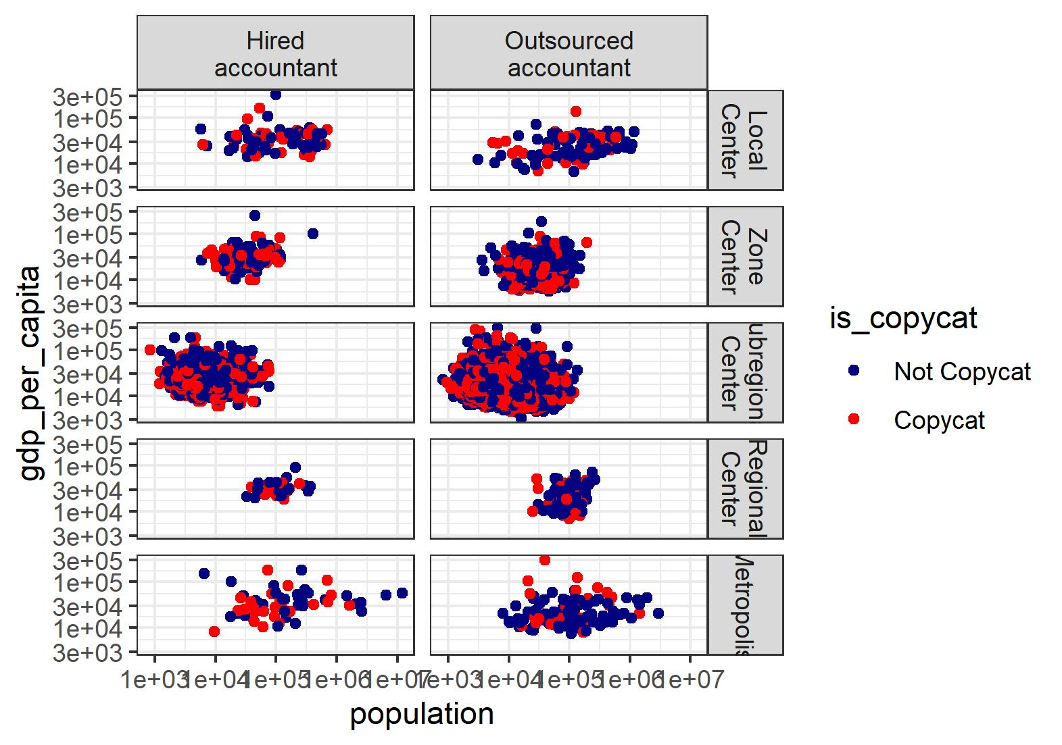

Copycat and non-copycat seem to have the same characteristics.
How to distinguish between them?

Slide 11

analysis
Multiple Imputation
27 models
Logit, Probit, Linear, Poisson, Quasi-Poisson and Negative Binomial
Logit & co.
Poisson & sons
27 models
Multiple imputation

Slide 12

Nothing comes from nothing: AUC = 57% (On predicting who copies) RMSE= 1.7 (On predicting Number of accounts copied)

Slide 13
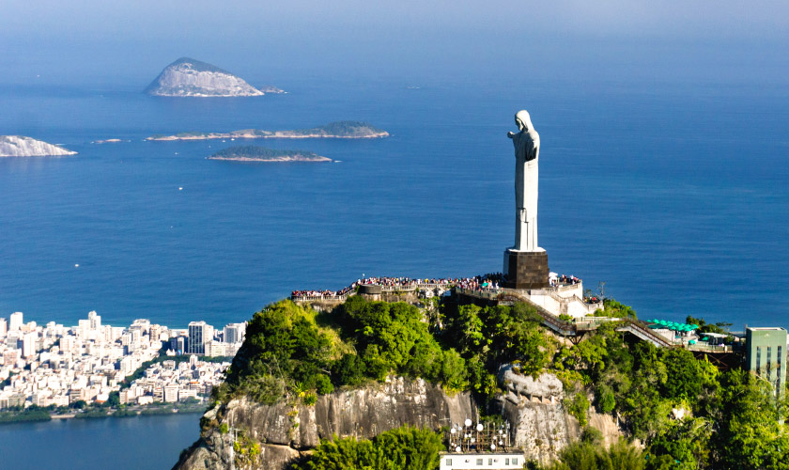
Significant relationships
Smaller cities are more likely to copy one another. Smaller. Not poorer. Not less developed. Just smaller.
Cities are actually less likely to copy when the accountant is outsourced
How many cities share the same accountant doesn’t matter

Slide 14
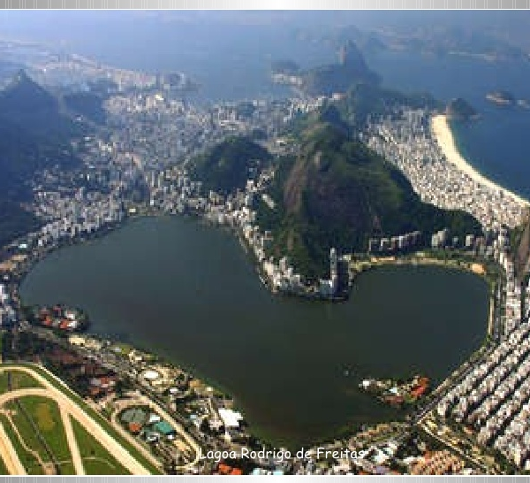
THANK YOU!

Slide 15
"municipality_id" "municipality"
[3] "state" "population"
[5] "n_copied_accounts" "is_copycat"
[7] "gdp" "gdp_per_capita"
[9] "urban_hierarchy" "accountant"
[11] "uncompliant_w_health_ministry" "outsourced_accountant"
[13] "nb_cities_same_accountant"
>

Slide 16
RAW Data
Treasury Department
Balance sheets 2018
Brazilian Institute of Geography and Statistics
GDP
Health Ministry
Accountant’s name and e-mail
Accruals 2018
Population
Region
Level of urbanization
Level of importance of the municipality to its surrounding cities
Submission date

Slide 17
1054061 financial accounts

Slide 18
TREASURY DEPARTMENT
BALANCE SHEETS (2018)
CHANGE IN WEALTH (2018)
SUBMISSION DATES
BRAZILIAN INSTITUTE OF GEOGRAPHY AND STATISTICS
GDP
MINISTRY OF HEALTH

